Slide 1



Separating Protein from Human Serum for Calcium Isotopic Analysis: Insights into Using ⁴⁴Ca/⁴²Ca as a Biomarker for Bone Metabolism
Quinn Shollenberger, ASU/NASA Space Grant
Mentors: Ariel Anbar, Melanie Channon, and Gwyneth Gordon
University of Arizona
April 12, 2014
Notes:
Hi! My name is Quinn Shollenberger and I am a senior studying chemistry in the Department of Chemistry and Biochemistry at Arizona State University. Today, I would like to introduce to you and explain my project along with our most current results. My project is separating protein from human serum for calcium isotopic analysis: insights into using 44Ca/42Ca as a biomarker for bone metabolism.

Slide 2
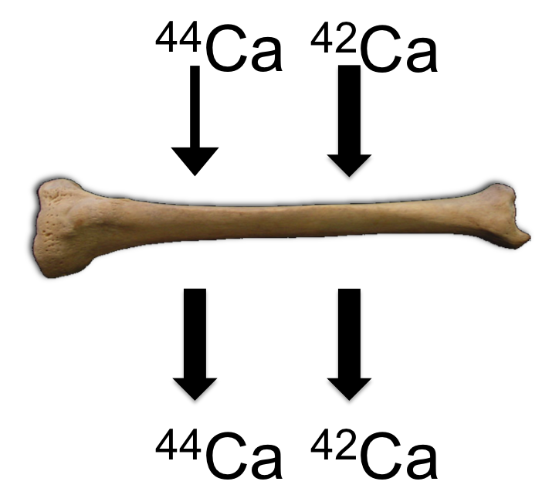
Motivation
Ca isotopes in urine were shown to track bone loss during bed rest studies
Bone’s preference for lighter isotopes is a phenomenon known as fractionation
Potential biomarker applications for detecting bone loss: multiple myeloma and other cancers that metastasize to bone, osteoporosis, long term space flight
Are there other fractionations in addition to bone that are
happening elsewhere in
the body
- Ca binding proteins
in human blood
serum
⁴⁴Ca/⁴²Ca_{bone}<⁴⁴Ca/⁴²Ca_{soft tissue}
Notes:
In order to understand my topic, I’d like to give some background on Ca isotopes. Ca isotopes in urine were shown to track bone loss during bed rest studies conducted by NASA to simulate a low-gravity environment. During bone formation lighter Ca isotopes are incorporated into bone, and during dissolution, this light Ca is released back into the soft tissue such as blood and urine. Bone’s preference for lighter isotopes is a phenomenon known as fractionation. This could be a useful biomarker for detecting bone loss. Multiple myeloma is a blood cancer found in bone marrow that is known to cause severe lesions in bone and bone density loss. This is the primary cancer that we are trying to validate this with. In the future, we think it could be useful for other diseases such as osteoporosis. It is also useful to detect bone loss in certain cancers which metastasize to bone. These cancers include breast cancer and prostate cancer. Finally, another application is detecting bone loss in astronauts on long term space flights. In order to better understand Ca isotopes in the human body, my project examines Ca isotopes in human serum. It is unknown whether Ca isotopes also fractionate in human serum, which is the blood minus red and white blood cells. A large portion of human serum is composed of proteins, some of which specifically bind Ca. Our aim is to test whether these proteins also fractionate Ca.

Slide 3
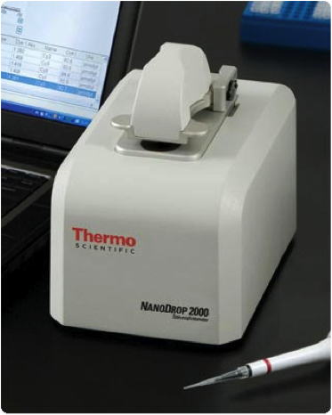
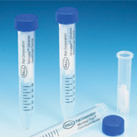
Separation of Protein from the Flow Through
Protein
Flow Through
Microseps used for protein separation. Image from Pall Corporation
NanoDrop 2000 spectrophotometer used to measure absorbance of proteins in samples. Image from Thermo Scientific
Notes:
In order to test whether proteins fractionate Ca, we first conducted a set of experiments to explore how to effectively separate the protein from the rest of the serum. This is important because we want to measure the Ca isotopes in the protein portion and the media portion. The media portion is the serum without the proteins. We first diluted the serum by creating a solution composed of one part human serum to four parts saline and centrifuged it using microseps. The microseps have a filter that allows the media to pass through but keeps the protein in the top portion. Smaller proteins may slip through the filter but the majority will be kept in the top. Then a NanoDrop 2000 spectrophotometer was used to measure the absorbance of the protein in the media and protein samples in order to determine the protein concentration. The protein concentration is important to ensure that we have the best separation.

Slide 4
Protein Concentration of Serum Samples
Notes:
Shown is the protein concentration of the protein pools after centrifugation, plotted against time of centrifugation. The centrifuging time needed to effectively separate the protein from the media in human serum was 90 minutes.

Slide 5
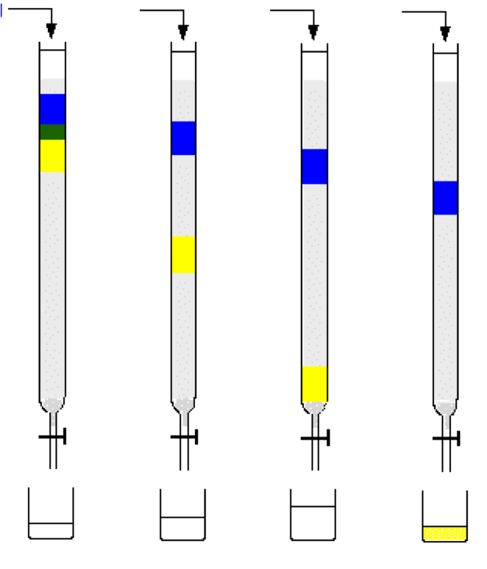
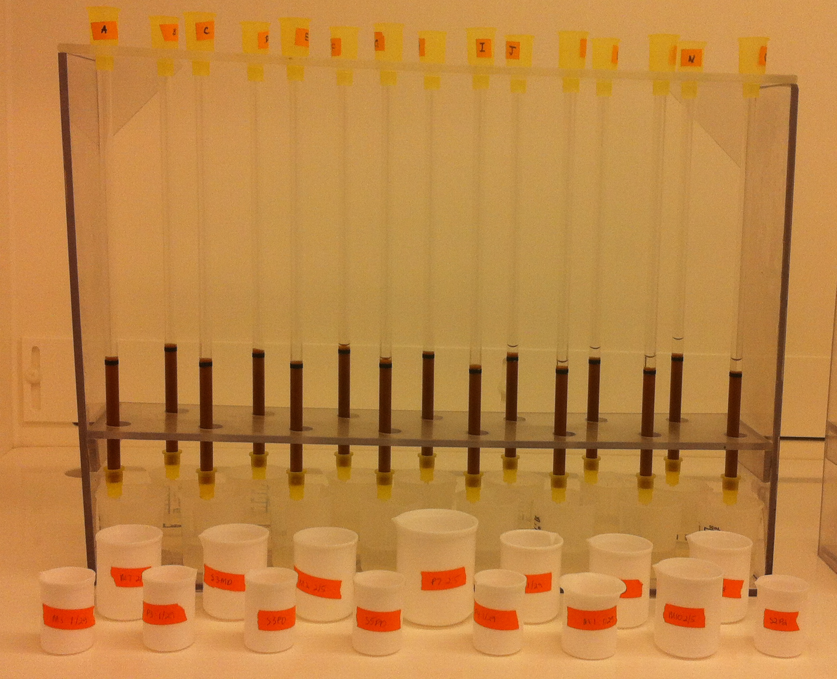
Methods
Samples during Calcium columns.
Example of how ion-exchange resin works.
-Protein and Flow Through samples go through digestion and column chemistry to eliminate interferences in the measurements of the calcium isotopic composition
Notes:
After finding the most effective separation time, the samples (both protein and media) went through digestion and column chemistry. Digestion frees the samples of any organics. Column chemistry involves getting rid of all the metals and elements in the sample besides calcium so I can properly look at the calcium ratio. Certain elements can cause interferences in the instruments so it’s important to have just calcium in the sample. The samples were added to ion exchange resin in hydrochloric acid which kept the calcium and strontium in the column. Then hydrobromic, hydrofluoric, and 2.5M hydrochloric acid were used to remove all the metals besides calcium and strontium. The calcium and strontium are eluted using 6M HCl. Next, the samples went on strontium columns that have another ion exchange resin. The samples are loaded in nitric acid which kept the strontium on the column. Calcium is eluted through the columns using nitric acid.

Slide 6
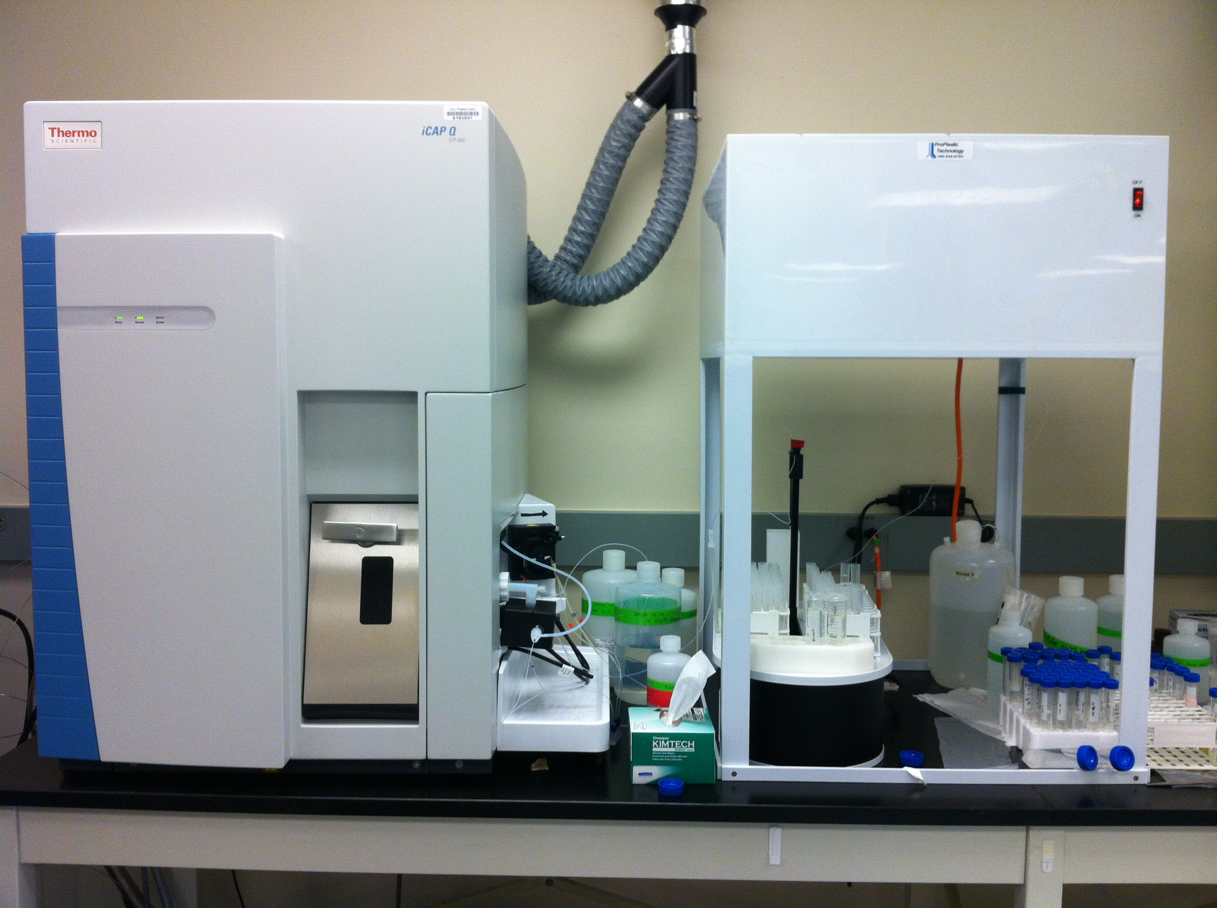
Inductively Coupled Plasma-Mass Spectrometry (ICP-MS) Measurements
iCAP-Q (ICP-MS) to measure Ca concentrations
Notes:
After column chemistry, an aliquot of each sample was analyzed on the iCAP-Q to determine the Ca concentrations. The iCAP-Q is an ICP-MS that is used to measure the concentrations of the metals in the samples, specifically Ca and any other metal that may interfere in the analysis. The ideal amount of Ca needed for accurate measurements on the MC-ICP-MS is 25 micrograms. The MC-ICP-MS is a multi collector that can measure isotope ratios.

Slide 7
Amount of Calcium in Protein and Flow Through Samples
Flow through samples at effective separation
Protein samples at effective separation
Notes:
Most of the media (serum without protein) samples have plenty of Ca for analysis. However, the protein samples, specifically at 90 minutes, do not have enough Ca for accurate measurements on the MC-ICP-MS.

Slide 8
Final Conclusions
Centrifugation time for effective separation is 90 minutes
Flow through samples have plenty of calcium
To do
  -Repeat separation with higher human blood serum concentration
  -measure all samples for calcium isotopic
  analysis
Notes:
Thus far, we have concluded that the centrifuging time needed to effectively separate the protein from the media in human serum was 90 minutes. We found out that the media samples have enough calcium for isotope ratio analysis. The protein samples, specifically at 90 minutes, do not have enough Ca for accurate measurements on the MC-ICP-MS. The separation experiments were repeated but the initial serum/saline solution was changed to have a higher protein concentration. The same steps of digestion and column chemistry are being repeated in order to attain a greater amount of Ca in the protein samples. The samples will then be processed on the MC-ICP-MS to examine the isotopic composition of both the media and protein pools, to see if they are the same, or whether there is a fractionation associated with Ca binding to protein.

Slide 9
Acknowledgements
Advisors
  Ariel Anbar
  Melanie Channon
  Gwyneth Gordon
Funding
  NASA Space Grant Program
Notes:
I’d like to thank my advisor Ariel Anbar for allowing me this opportunity to work with the lab group and assist with funding for this project. I’d like to thank research scientist Gwyneth Gordon and post-doctoral scholar Melanie Channon for all of their help with this project and for being my mentors. I’d finally like to thank NASA Space Grant program for funding this project.

